Slide 1



Bayesian Graphical Modeling
A hands-on tutorial
What is psychometrics? 2024
n.sekulovski@uva.nl
Bayesiangraphicalmodeling.com
Credit for slides: Karoline Huth

Slide 2





Session setup
Part I: History
Part II: Theory
Part III: Tutorial
Part IV: Practical
image: Flaticon.com

Slide 3
Session setup
Part I: History
Part II: Theory
Part III: Tutorial
Part IV: Practical
Interpretation
Priors
Analysis (R)
image: Flaticon.com

Slide 4
interpretation

Slide 5
Two questions in network analysis
1
1
Is there an effect?
1
2
3
2
3
1
1
2
3
2
3
2
3
What is the effect?

Slide 6
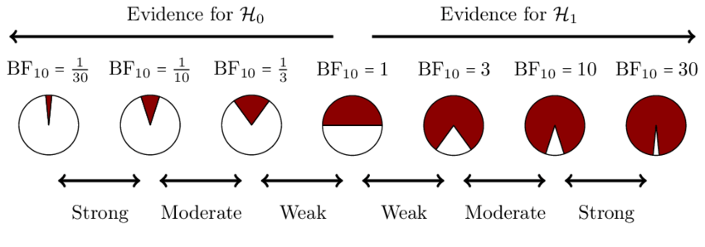
Bayesian hypothesis testing
Bayes factor as a continuous measure of support

Slide 7
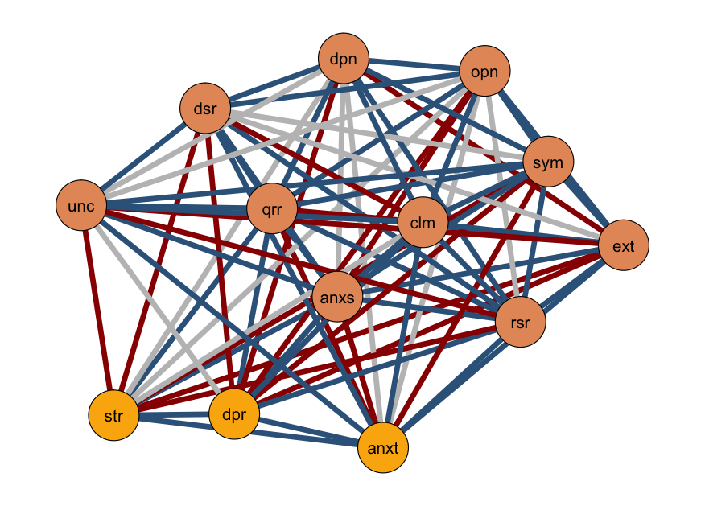
Edge evidence plot
Edge:
Inclusion Bayes factor for each edge (in categories)
Edge Color:
Evidence for inclusion
Inconclusive
Evidence for exclusion

Slide 8
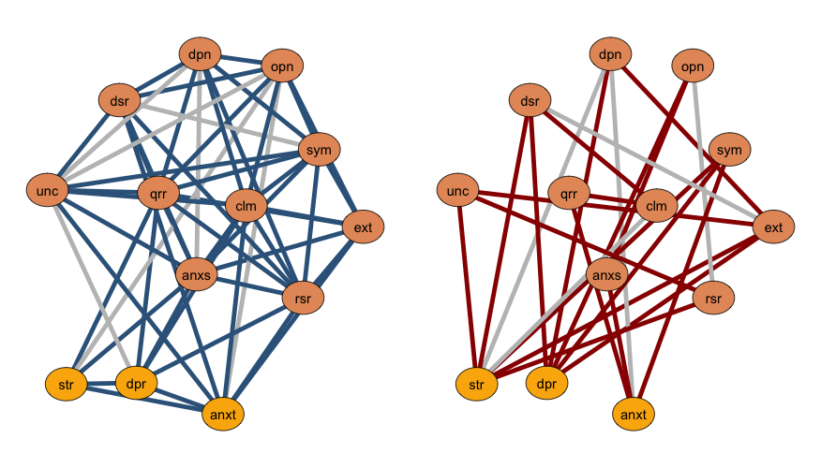
Edge evidence plot - split
Edges with a BF > 1; included
Edges with a BF < 1; excluded

Slide 9
Two questions in network analysis
1
1
Is there an effect?
1
2
3
2
3
1
1
2
3
2
3
2
3
What is the effect?

Slide 10
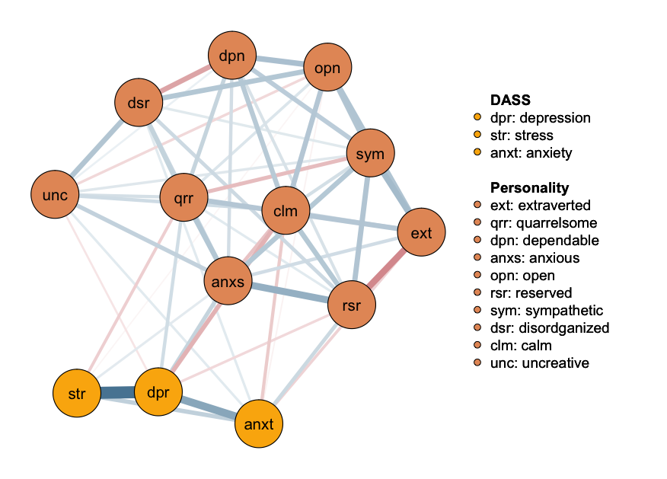
Network Plot
Median probability plot:
Edges with a BF > 1
Edge:
Partial association
parameter
Edge Color:
positive relations
negative relations

Slide 11
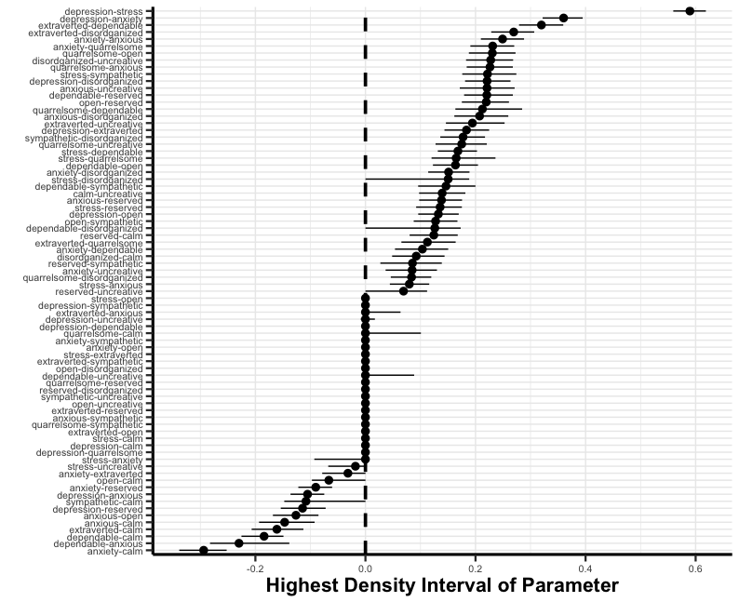
Forest plot
Highest density interval
Shortest interval covering 95% of the posterior mass

Slide 12
priors

Slide 13
Prior – specification
Structure Prior
What prior assumptions do I have about the density? Do I believe a particular edge should be included?
Parameter Prior
What prior assumptions do I have about the strength of the edge weights?
Notes:
The unit information prior is a data-dependent prior, (typically multivariate Normal) with mean at the MLE, and precision equal to the information provided by one observation.

Slide 14
How do I get to my prior?
Objective Prior:
Defining an “uninformative” prior distribution
Subject matter expertise:
Using “expert” knowledge on a topic
Previous research:
Using previous (network) study results
Empirical data:
Using data that is similar/relevant to the one you want to assess
Always conduct a prior sensitivity check
Notes:
Objective priors: In some cases, you may want to use an objective specification of the prior probabilities that meets certain criteria. For example, in the lecture, we specified the prior probabilities to reflect our indifference to a particular structure. You could also specify the prior probabilities to account for the fact that we are making multiple.
Subject matter expertise: If you have a good understanding of the problem at hand and the context in which the data were collected, you can use your expertise to inform the prior distribution. Or you can elicit this information from other experts.
Previous research: If there is prior research on the topic, you can use the results of that research to inform the prior distribution. For example, you may find that certain relationships are almost always in the network or almost never; you may find that networks have very many relationships or only a few; you may find that variables are always positively related.
Empirical data: If you have some data that is similar or relevant to the data you want to analyze, you can use it to inform the prior distribution.

Slide 15
analysis

Slide 16


Software implementations
based on BDgraph
easybgm
all
BDgraph
mixed, continuous, ordinal, binary
BGGM
mixed, continuous, ordinal, binary
bgms
ordinal, binary

Slide 17
Session setup
Part I: History
Part II: Theory
Part III: Tutorial
Part IV: Practical
image: Flaticon.com

Slide 18
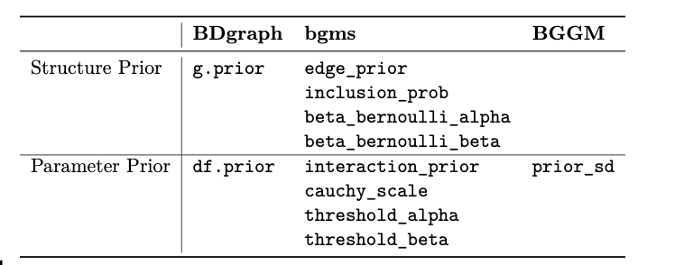
Prior – specification
Structure Prior
What prior assumptions do I have about the density? Do I believe a particular edge should be included?
Parameter Prior
What prior assumptions do I have about the strength of the edge weights?
Notes:
The unit information prior is a data-dependent prior, (typically multivariate Normal) with mean at the MLE, and precision equal to the information provided by one observation.

Slide 19
Resources
Huth, K. B. S., de Ron, J., Goudriaan, A. E., Luigjes, J., Mohammadi, R., van Holst, R. J., Wagenmakers, E.-J., & Marsman, M. (2023). Bayesian analysis of cross-sectional networks: A tutorial in R and JASP. Advances in Methods and Practices in Psychological Science, 6(4).
Huth, K., Keetelaar, S., Sekulovski, N., van den Bergh, D., & Marsman, M. (2024). Simplifying Bayesian analysis of graphical models for the social sciences with easybgm: A user-friendly R-package. https://doi.org/10.31234/osf.io/8f72p
Marsman, M., van den Bergh, D., & Haslbeck, J. M. B. (in press). Bayesian Analysis of the Ordinal Markov Random Field. Psychometrika
Sekulovski, N., Keetelaar, S., Huth, K., Wagenmakers, E. J., van Bork, R., van den Bergh, D., & Marsman, M. (in press). Testing conditional independence in psychometric networks: An analysis of three Bayesian methods. Multivariate Behavioral Research, 1-21.
https://bayesiangraphicalmodeling.com/
https://github.com/KarolineHuth/easybgm
https://maartenmarsman.github.io/bgms/

